Slide 1
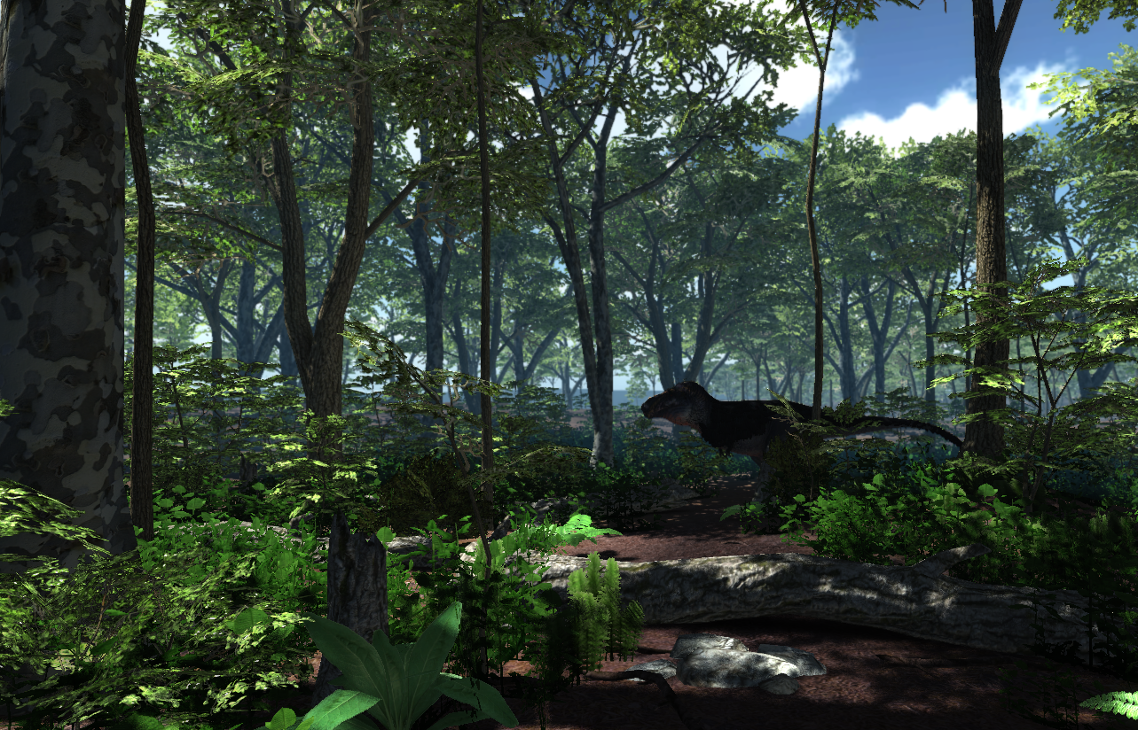
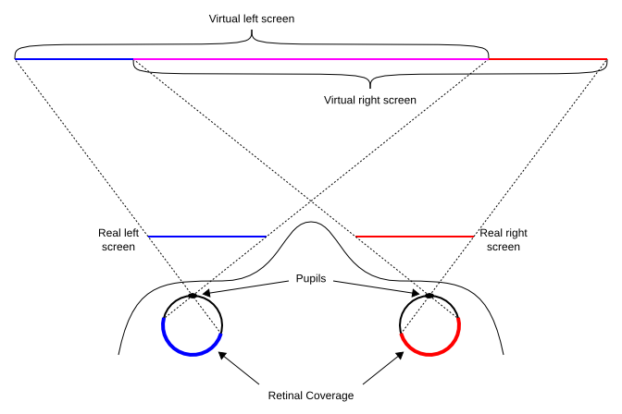
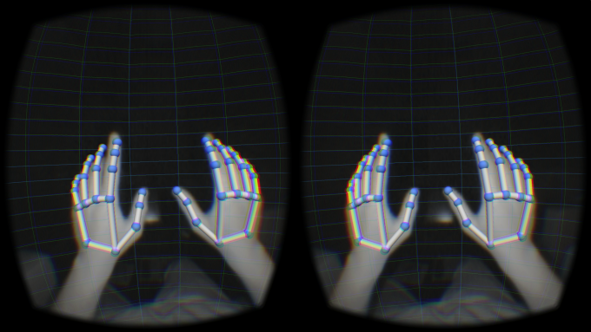
Reading in the Ether
Team: Cameron Meyers, Gabe Quiñones, Zach Schwaiger Advisor: Dr. Aleshia Hayes
Abstract
Database Management
User Experience
Virtual reality (VR) can be used to create deeply immersive experiences, as well as to add depth and complexity to visualizations. This modern immersive capability can be utilized to create deep experiences for users and can be leveraged to highlight complex visualizations. The Interactive Virtual Library (IVL) creates a VR library system that allows users to search through books, immerse themselves in scenic environments for reading, and observe relationships between documents based on keyword indexing.
Creates plain text repository based on Gutenberg corpus (~50,000 books)
Creates and manages a database of metadata (e.g. author, title) for each book for querying
Serves up queries from library using PHP script hosted on local server.
Indexes books for keywords (i.e. non stop words)
Runs searches over keywords using Apache Lucene, returning relevant results.
Creates immersive experience of reading using a blend of VR and gesture tracking technologies.
Uses custom-made virtual books to allow gesture-based manipulation.
Gesture-based keyboard allows custom queries for books
Uses query results to procedurally generate books for the user.
Exists in a forest-like environment to promote relaxation.
Gesture Tracking
Uses Leap Motion gesture tracking device mounted to Oculus Rift and available API.
Implements custom gesture detectors to select books for reading
Uses specialized swipe tracking service to manipulate selected book (open, turn page, etc.).
Overview
Creates a 3D space for users to interact with and read books from a library
Uses gesture tracking as the sole input medium
Procedurally generates books based on searches ran against a database of texts
Manages local repository of books, a database of book metadata, and runs searches based on metadata or keyword indexing
Future Work
Update user interface to be more streamlines and cleaner
Implement select-and-search for relevance visualizations
Heighten ambiance through variety in environments and sounds.
Re-implement back-end on a web server.
Contact Information: Cameron Meyers – meyeca03@students.ipfw.edu, Dr. Hayes – hayesa@ipfw.edu

